Slide 1
Phishing Awareness Training
Presented by: Saif Ullah

Slide 2
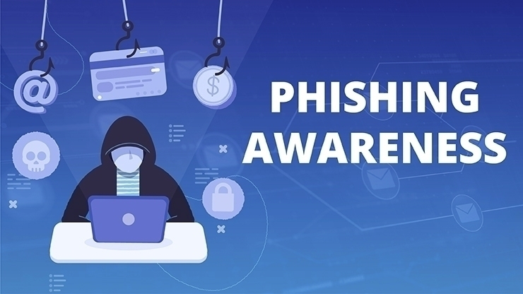
Phishing Awareness Training

Slide 3
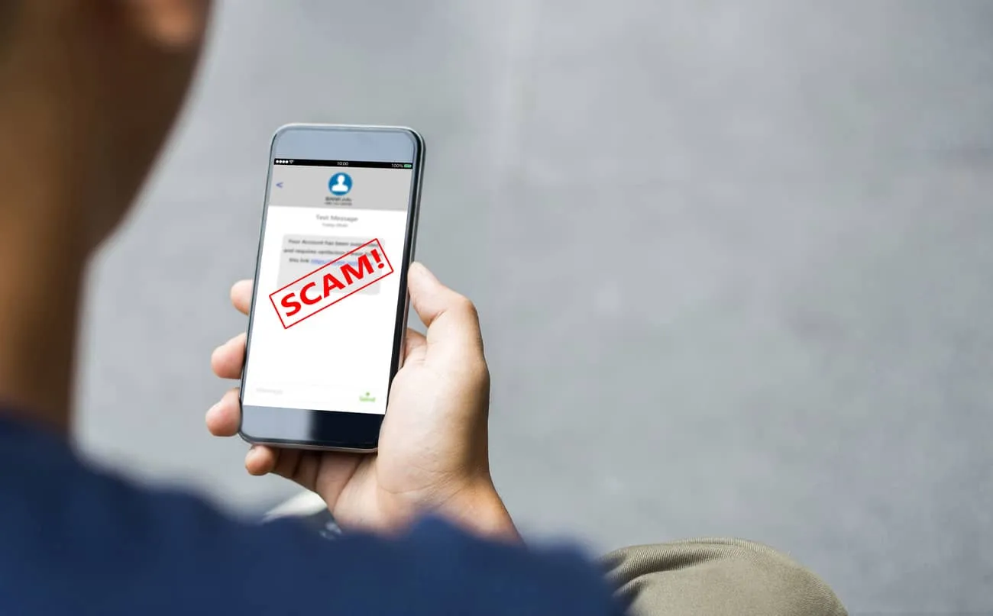
Introduction
Protect Yourself from Cyber Threats

Slide 4
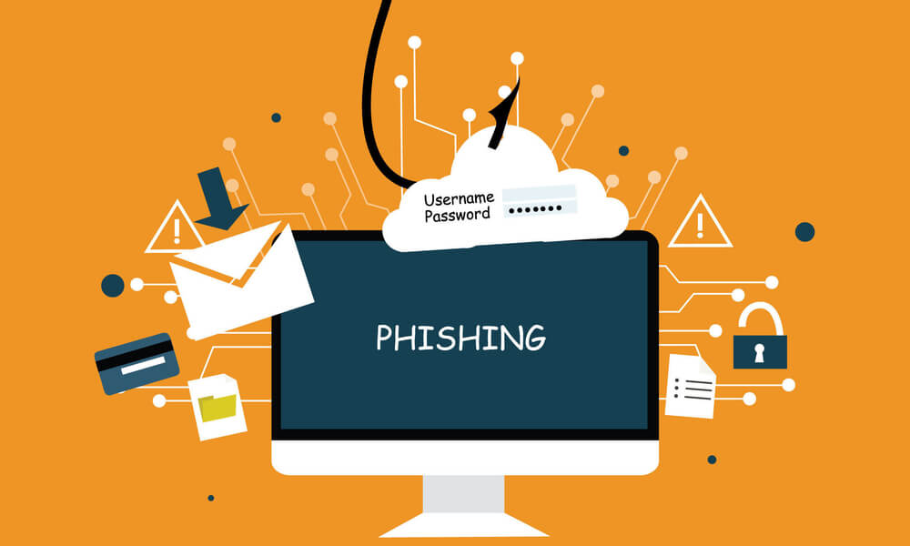
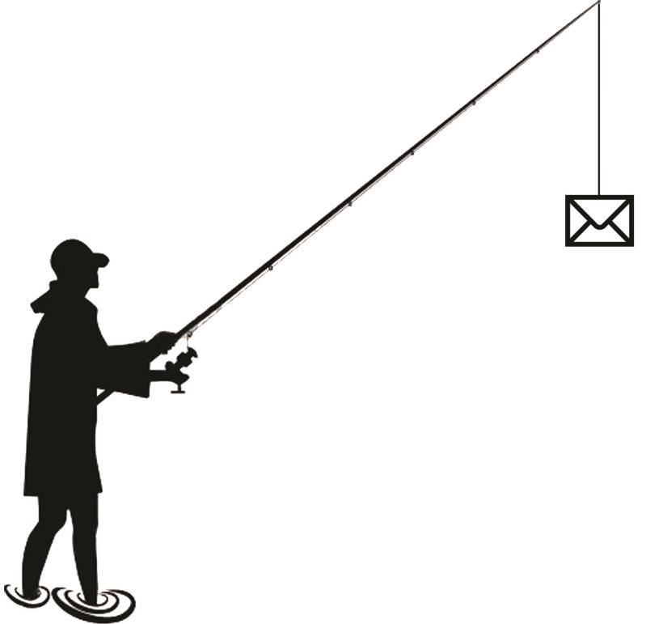
Phishing

Slide 5
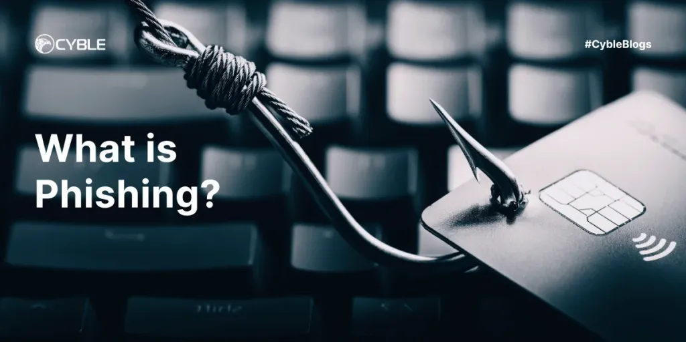
What is Phishing?

Slide 6
What is Phishing?
Phishing is a cyberattack that uses disguised emails, websites, or messages to trick you into revealing personal information, like passwords, credit card numbers, or account details.
Goal of Phishing: To steal sensitive data or install malicious software.

Slide 7
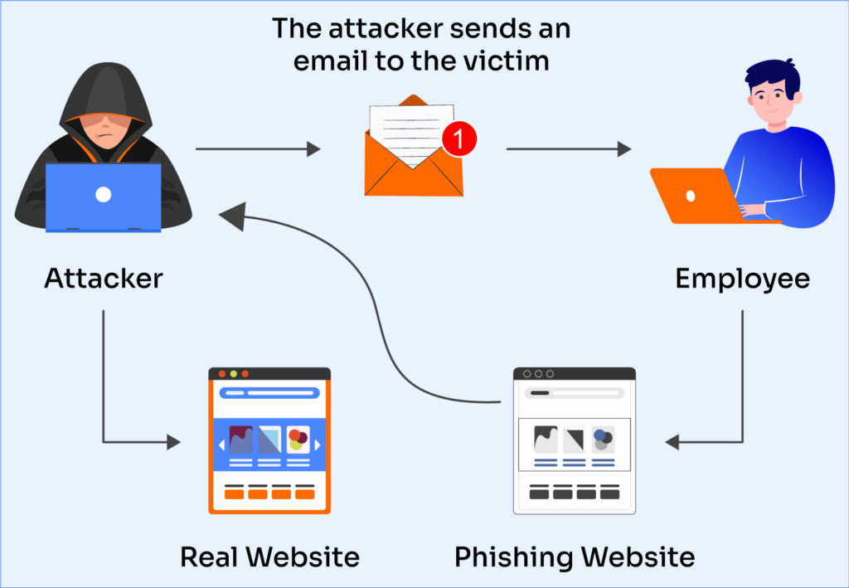
Real Phishing Attack

Slide 8
Real Phishing Attack
Story: In 2016, a phishing email led to a major breach of sensitive data at XYZ Corporation, causing financial loss and reputational damage.
What Went Wrong?: An employee clicked a malicious link disguised as an internal message.
Lesson Learned: Training and awareness could have prevented the breach.

Slide 9
Common Phishing Techniques
Email Phishing: Fake emails from trusted sources asking you to click a link or download an attachment.
Spear Phishing: Personalized emails targeting specific individuals or organizations.
Smishing: Phishing via SMS or messaging apps.
Vishing: Voice-based phishing attempts.
Clone Phishing: Duplicating legitimate emails and changing the attachments or links.

Slide 10
Recognizing Phishing Emails
Unusual Sender Email: Slight variations in email addresses.
Urgent or Threatening Language: "Act now!" or "Your account will be suspended!"
Suspicious Links: Hover over links without clicking to check for unusual URLs.
Unexpected Attachments: Never open attachments from unknown sources.
Grammar and Spelling Errors: Poorly written messages often indicate phishing.

Slide 11
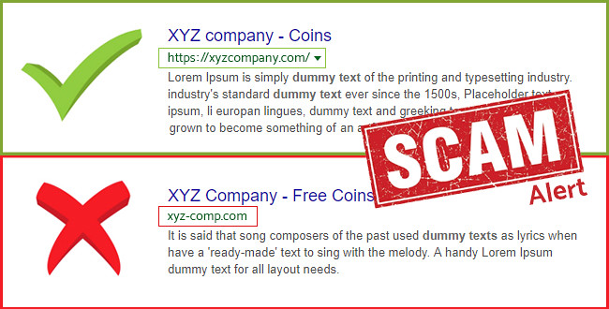
Phishing Websites

Slide 12
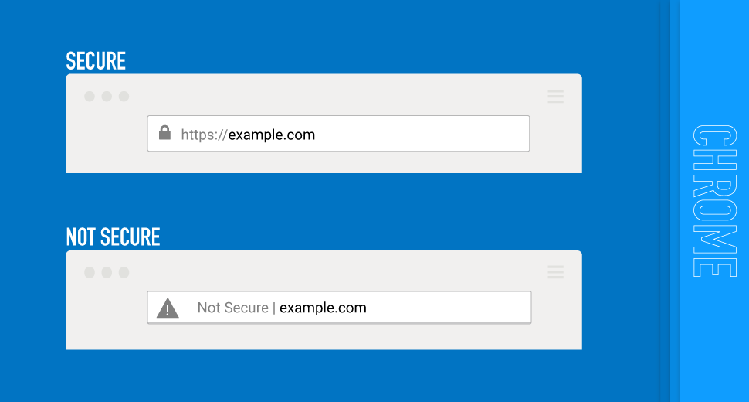
Lookalike Websites:
Attackers create fake websites that look like real ones (e.g., fake bank websites).

Slide 13
How to Spot Them:
Check for HTTPS: Secure sites have HTTPS in the URL.
Look for Misspellings: Minor differences in domain names (e.g., g00gle.com).
Unusual Pop-Ups: Legitimate sites rarely use excessive pop-ups asking for personal data.

Slide 14
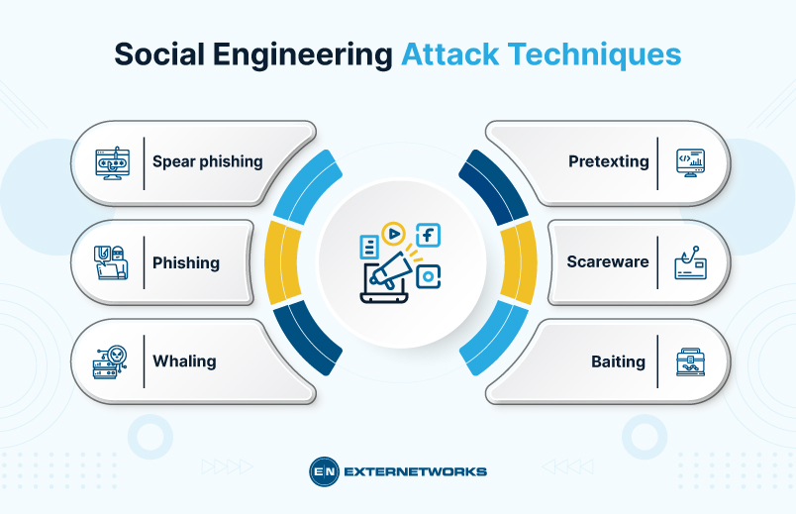
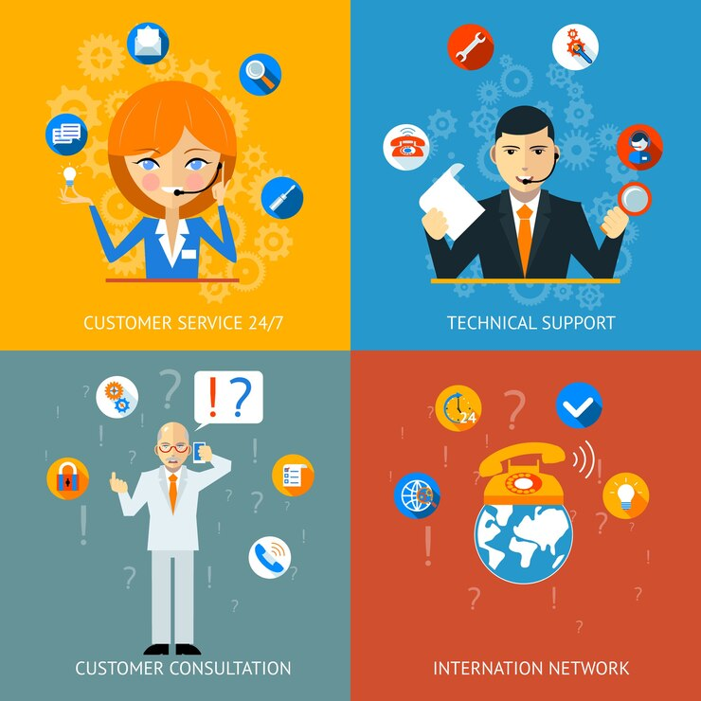
Social Engineering Tactics

Slide 15

What is Social Engineering?
Manipulating individuals into divulging confidential information.

Slide 16
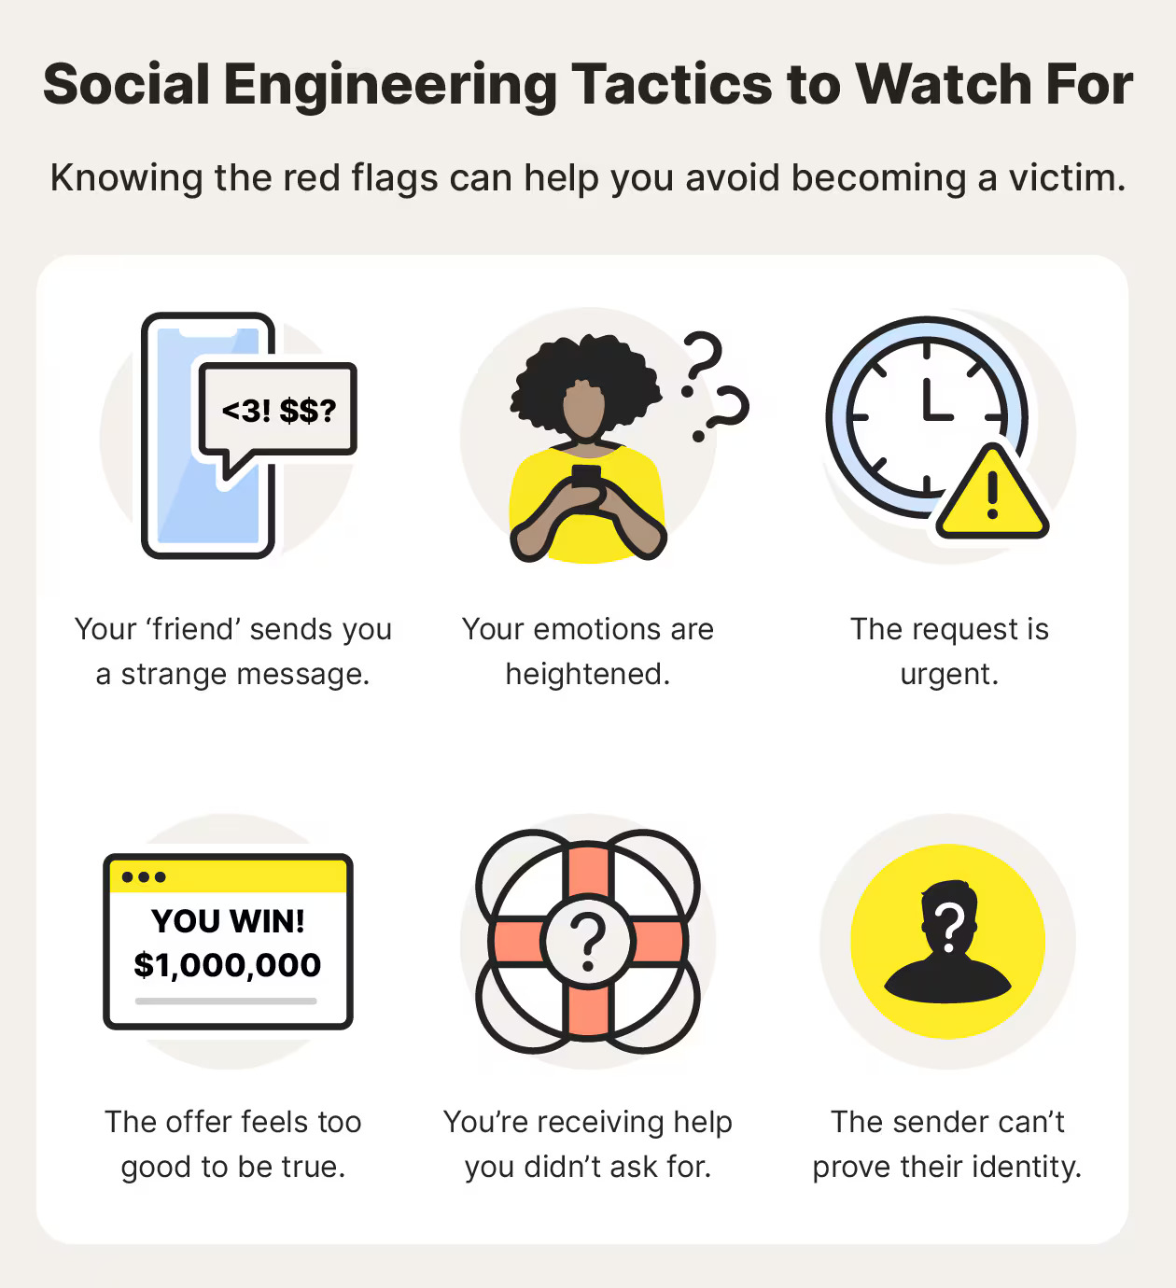
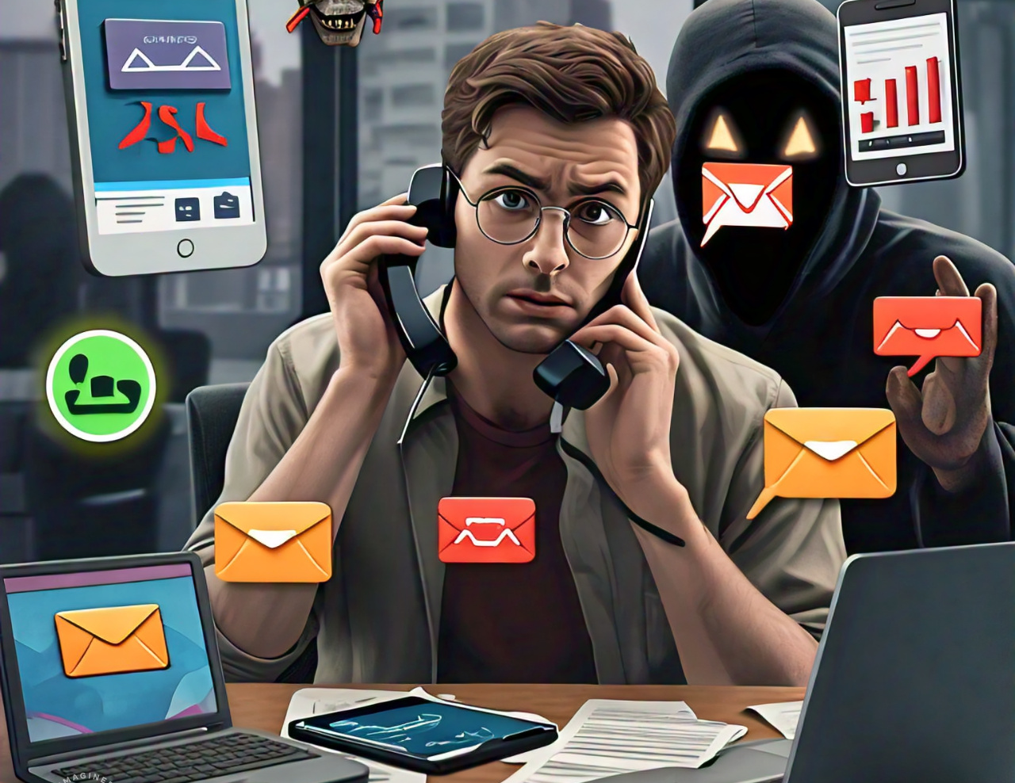
•Tactics:

Slide 17
Tactics:
Pretexting: Pretending to be someone you know (e.g., IT department or a boss).
Baiting: Offering something tempting (e.g., a free download) to get you to share information.
Tailgating: Physical intrusion by following someone into restricted areas.

Slide 18
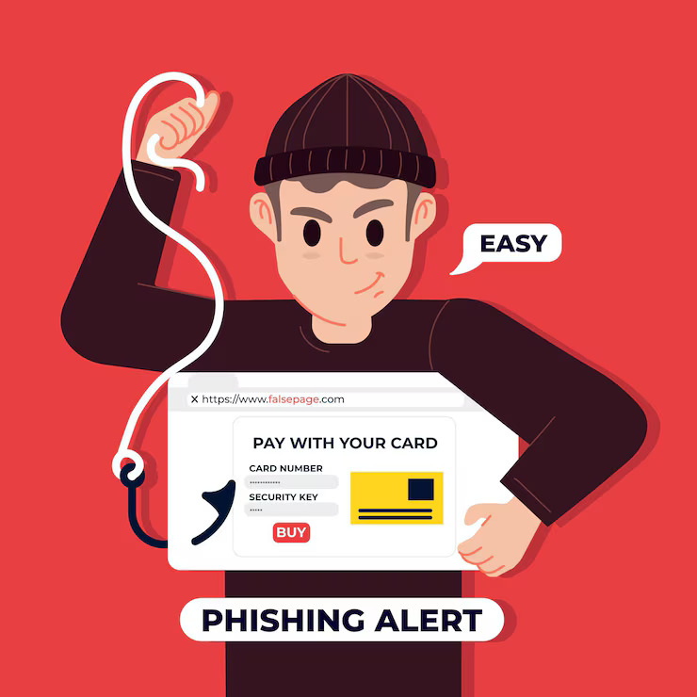
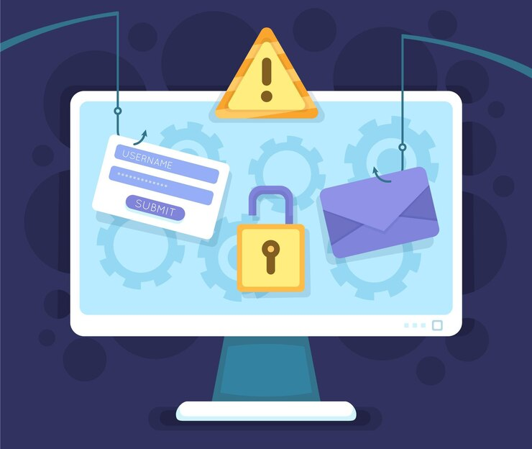
What to Do if You Suspect Phishing

Slide 19
•Steps to Take:
Don’t click on links or download attachments.
Report the email to your IT or cybersecurity team.
Verify the request by contacting the sender directly through known channels.
Use anti-phishing tools and keep software up to date.

Slide 20
Best Practices for Phishing Prevention
Stay Alert: Always be cautious with unexpected emails or messages.
Use Strong Passwords: Use unique and complex passwords for different accounts.
Enable Two-Factor Authentication (2FA): Adds an extra layer of security.

Slide 21
Cont....
Regularly Update Software: Security patches prevent vulnerabilities.
Educate Others: Share what you know to create awareness.

Slide 22
Key Points:
Phishing is a growing threat.
Stay vigilant and educate yourself on recognizing scams.
Always verify before clicking, sharing, or downloading.
Report suspicious activity immediately.

Slide 23

Thank You!

